Slide 1
Learning By Fixing And Extending Games
G. Costantini, G. Maggiore, A. Cortesi
University Ca’ Foscari – Venice (Italy)

Slide 2
Agenda
Two approaches
Learning by fixing
Learning by extending
Tools and technology
Follow-ups and Conclusions
Motivation

Slide 3
Agenda
Two approaches
Learning by fixing
Learning by extending
Tools and technology
Follow-ups and Conclusions
Motivation

Slide 4
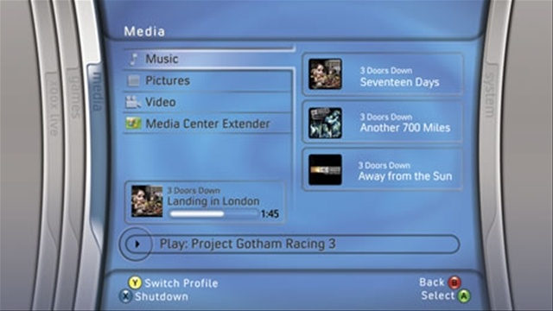

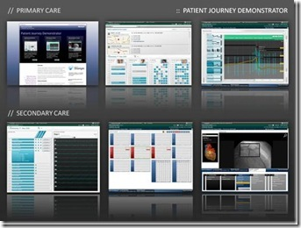
Motivation
CS students enter the University full of expectation for this…

Slide 5
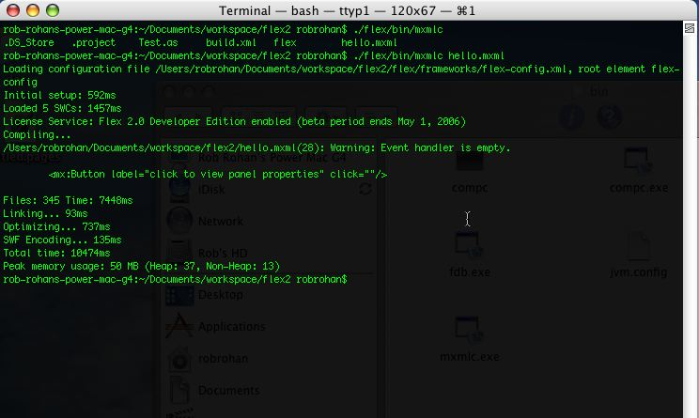
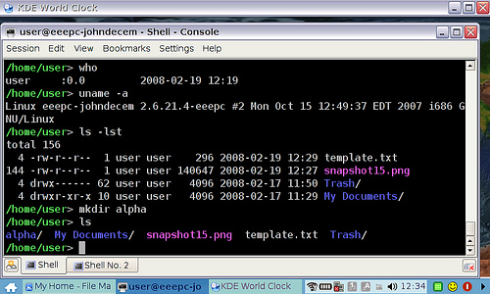
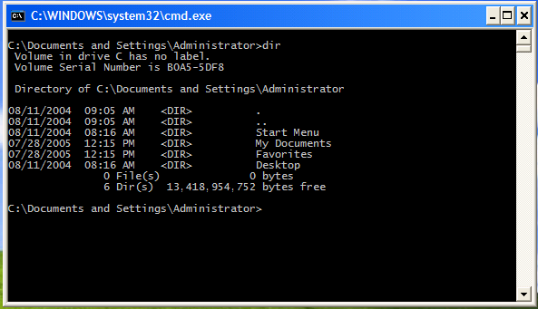
Motivation
And instead they get this…

Slide 6

Motivation
Average reaction:

Slide 7
Motivation
Through technology it is possible to achieve both
Academic Quality
Student Engagement

Slide 8
Agenda
Two approaches
Learning by fixing
Learning by extending
Tools and technology
Follow-ups and Conclusions
Motivation

Slide 9
Approach 1: Learning By Fixing
First year students
Give them a game and its source code
“Let’s play this!”
“It’s broken!”
“Why?”
…game fixed!

Slide 10
Approach 1: Learning By Fixing
Code is NOT some distant abstraction
Code ≡ program (game)
Learn to relate code to common experiences

Slide 11
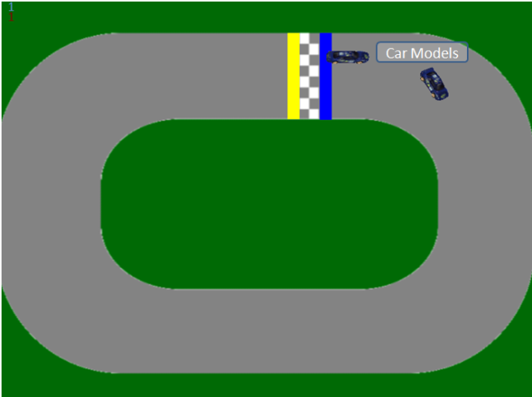
Approach 1: Learning By Fixing
Example: assignment on recursion
Typical assignment:
factorial
Game assignment:
find the exact moment of the collision amongst some cars

Slide 12
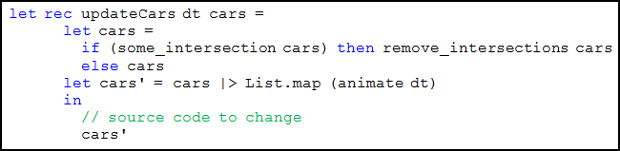
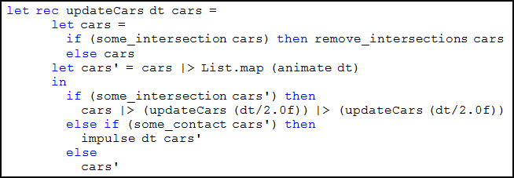
Approach 1: Learning By Fixing

Slide 13
Approach 2: Learning by Extending
3rd year students
More coding experience
Build a game following some constraints

Slide 14
Approach 2: Learning by Extending
Challenge 1:
Use an existing AI/logic library
By hiding it to the program under some interface

Slide 15
Approach 2: Learning by Extending
Challenge 2:
Assume that the library is slow
NO user waiting
Maximize multicore experience

Slide 16
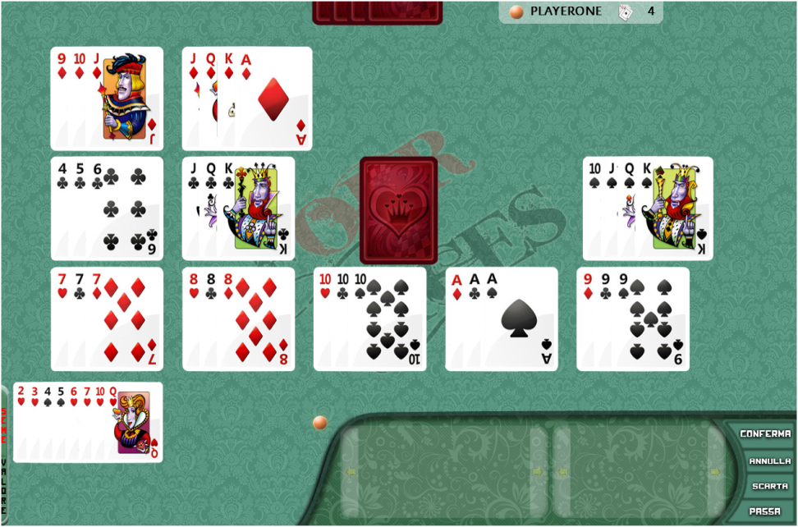
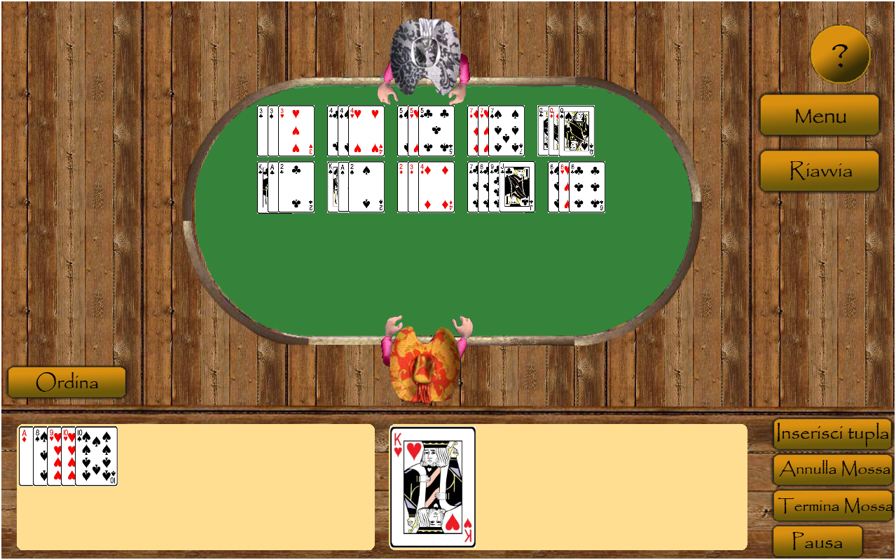
Approach 2: Learning by Extending
Some results were actually beyond our expectations
Both aesthetically...

Slide 17
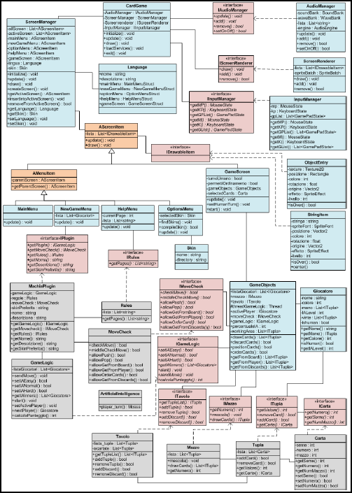
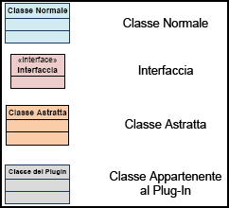
Approach 2: Learning by Extending
Some results were actually beyond our expectations
… and structurally

Slide 18
Agenda
Two approaches
Learning by fixing
Learning by extending
Tools and technology
Follow-ups and Conclusions
Motivation

Slide 19
Tools and Technology
These approaches simply FAIL with the wrong tools

Slide 20
Tools and Technology
It’s the era of parallelism + multimediality
We need to think in term of the new challenges

Slide 21
Tools and Technology
No low-level
No explicit memory management
Large libraries of utilities (sorry C/C++☺)

Slide 22
Tools and Technology
Any modern Virtual-Machined language will do:
JVM
CLI

Slide 23
Tools and Technology
We chose CLI:
C# (beautiful language)
F# (beautiful language)
Haskell, VB .Net, …

Slide 24
Tools and Technology
Plus a ton of libraries:
XNA for game development
…

Slide 25
Tools and Technology
Plus TFS (Team Foundation Server) + SP (SharePoint):
Collaboration solutions
Work/share from home and lab, even in groups
We always have access to any revision (get specific version)

Slide 26
Agenda
Two approaches
Learning by fixing
Learning by extending
Tools and technology
Follow-ups and Conclusions
Motivation

Slide 27
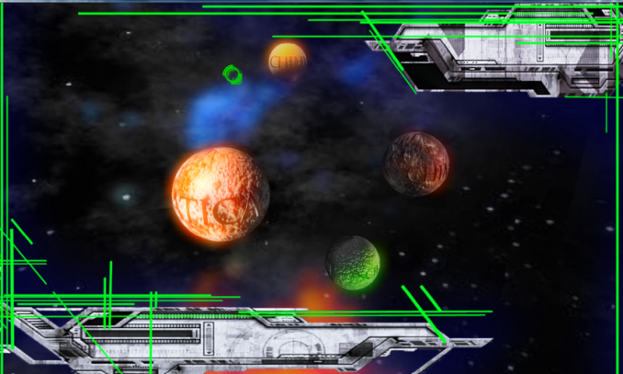
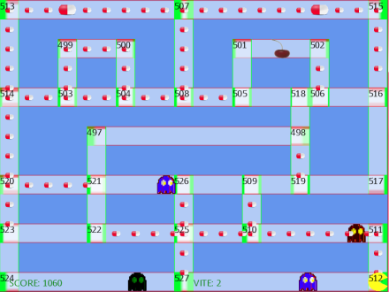
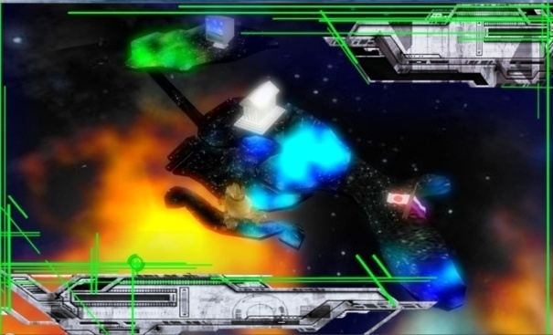
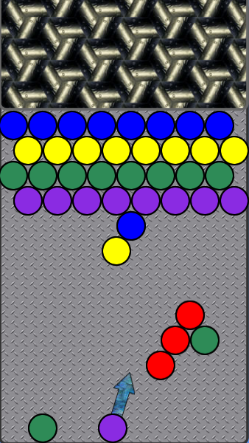
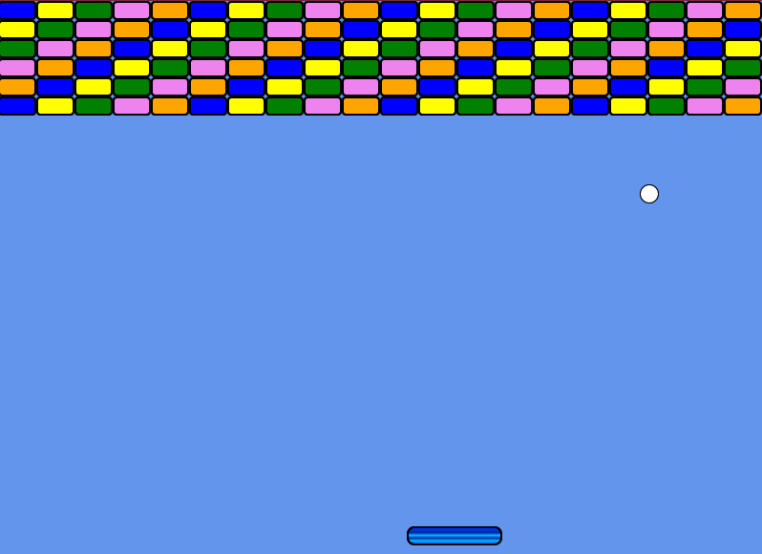
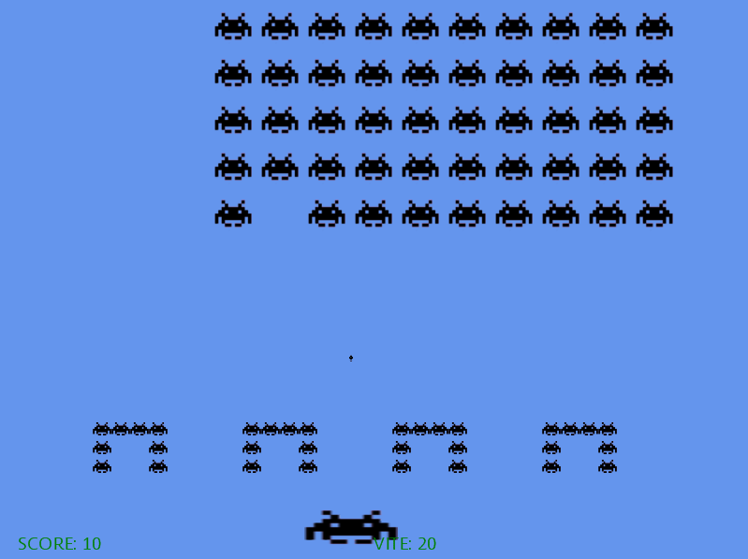
Follow-ups
VG Lab:
3rd year students (interested only)
Build a playable version of our university

Slide 28
Follow-up
One small game per exam
Cycle is: think, abstract, write
Very little bugs, lots of reasoning before writing code
Functional programming in LINQ

Slide 29
Conclusions
Empowering students: they master “computers”
“Computers” are things where cool stuff happens (defined by users, not by academia)…
…NOT large and powerful pocket calculators

Slide 30
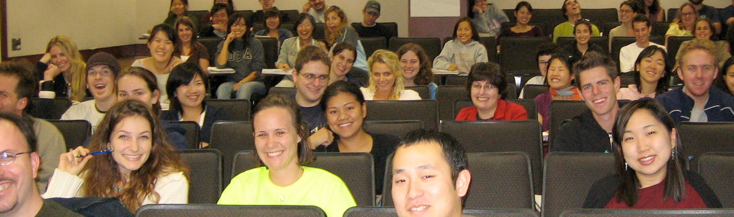
Conclusions
Engaged students work far harder…
… and are much happier!

Slide 31
Questions?
Thank you!

